Slide 1
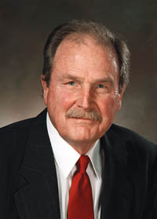
David Huffman
Build the tree (code) bottom-up in a greedy fashion

Slide 2
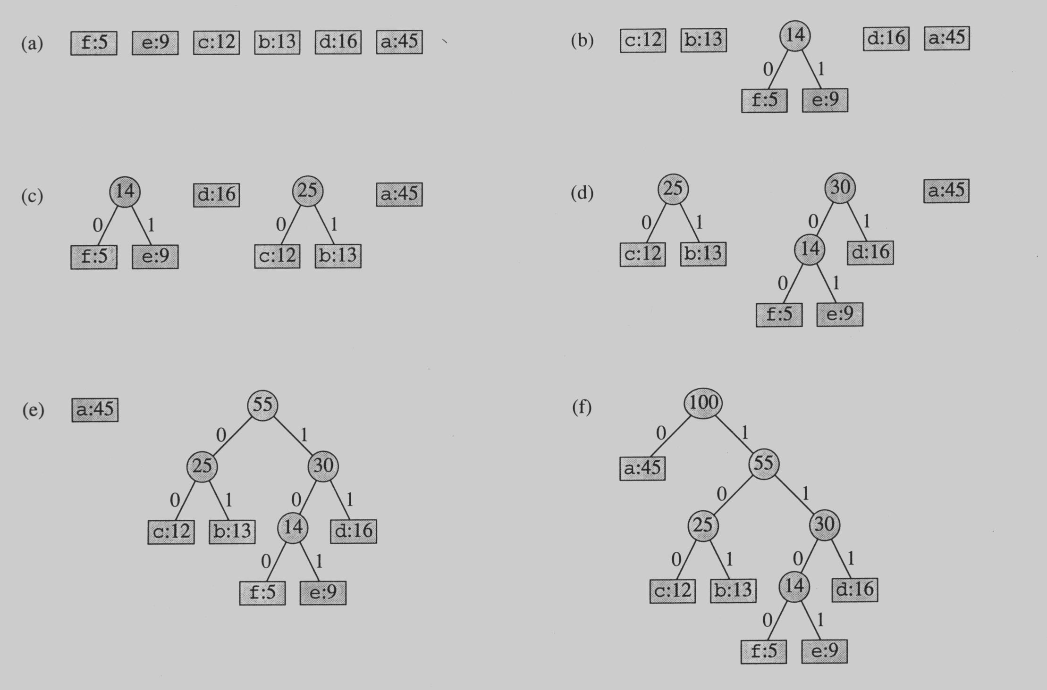
Building the Encoding Tree

Slide 3
Building the Encoding Tree

Slide 4
Building the Encoding Tree

Slide 5
Building the Encoding Tree

Slide 6
Building the Encoding Tree

